Slide 1
Basic English Grammar for Academic Writing

Slide 2
Outline
Fundamental Concepts Academic Writing
Parts of English Grammar
Some Notes on Writing
Logical Structure of Writing and Presenting Articles

Slide 3
Academic Writing
Is a formal style of writing.
Is based on FACTS and EVIDENCES and It is NOT affected by PRESONAL EMOTIONS.
Is to present information in order to display a clear understanding of a particular subject.
Examples:
Books
Research papers
Journals
Conference papers
Abstract
Thesis
News articles
Formal writing:
Tone should NOT sound casual or conversational.
Avoid using SLANG (俚語) or IDIOMATIC (慣用語) expressions.
Choose EXPANDED forms over CONTRACTED forms.

Slide 4
Academic Writing
SLANG/IDOMATIC/INFORMAL | FORMAL
Go | Depart
Go up | Increase
Let | Allow
Need | Request
Tell | Inform
Wrong | Incorrect
Throw away | Discard
Top notch | Highly valuable
A lot of | A great deal of
Examples:
With women, there is a lot of pressure to conform to a certain physical shape. X
With women, there is a great deal of pressure to conform to a certain physical shape. √

Slide 5
Academic Writing
CONTRACTED FORM | EXPANDED FORM
Doesn’t | Does not
Can’t | Cannot
They’ve | They have
It’s | It is
We’ll | We will
You’re | You are
Isn’t | Is not
Gonna | Going to
Examples:
The policy doesn’t permit illegal dealings. X
The policy does not permit illegal dealings. √

Slide 6
Fundamental concepts
Words
Sentences
Paragraphs
Sections/Sub-Sections
Title
Abstract
Introduction
Results
Discussion
Conclusion
Scientific Article

Slide 7
Elements of writing
Sentence has no unnecessary words…
Paragraph has no unnecessary sentences…
Drawing has no unnecessary lines…
Figure/Table has no unnecessary data…
This requires …. “that the writer makes all his/her sentences short and every word tell.”
“Vigorous writing is precise; concise; specific”

Slide 8
Sentence construction
Sentence (句子) is a group of words with a subject, a verb and an object that expresses a complete thought.
Clause (子句) is a subject and a predicate (敘述).
Fragment (不完整句): Group of words that is missing a subject or verb. No complete thought.
A run-on (不間斷句)：two or more independent clauses that are not joined properly.
Phrase (片語): Group of words that express a complete thought but not a complete sentence. Do not contain the subject and verb

Slide 9
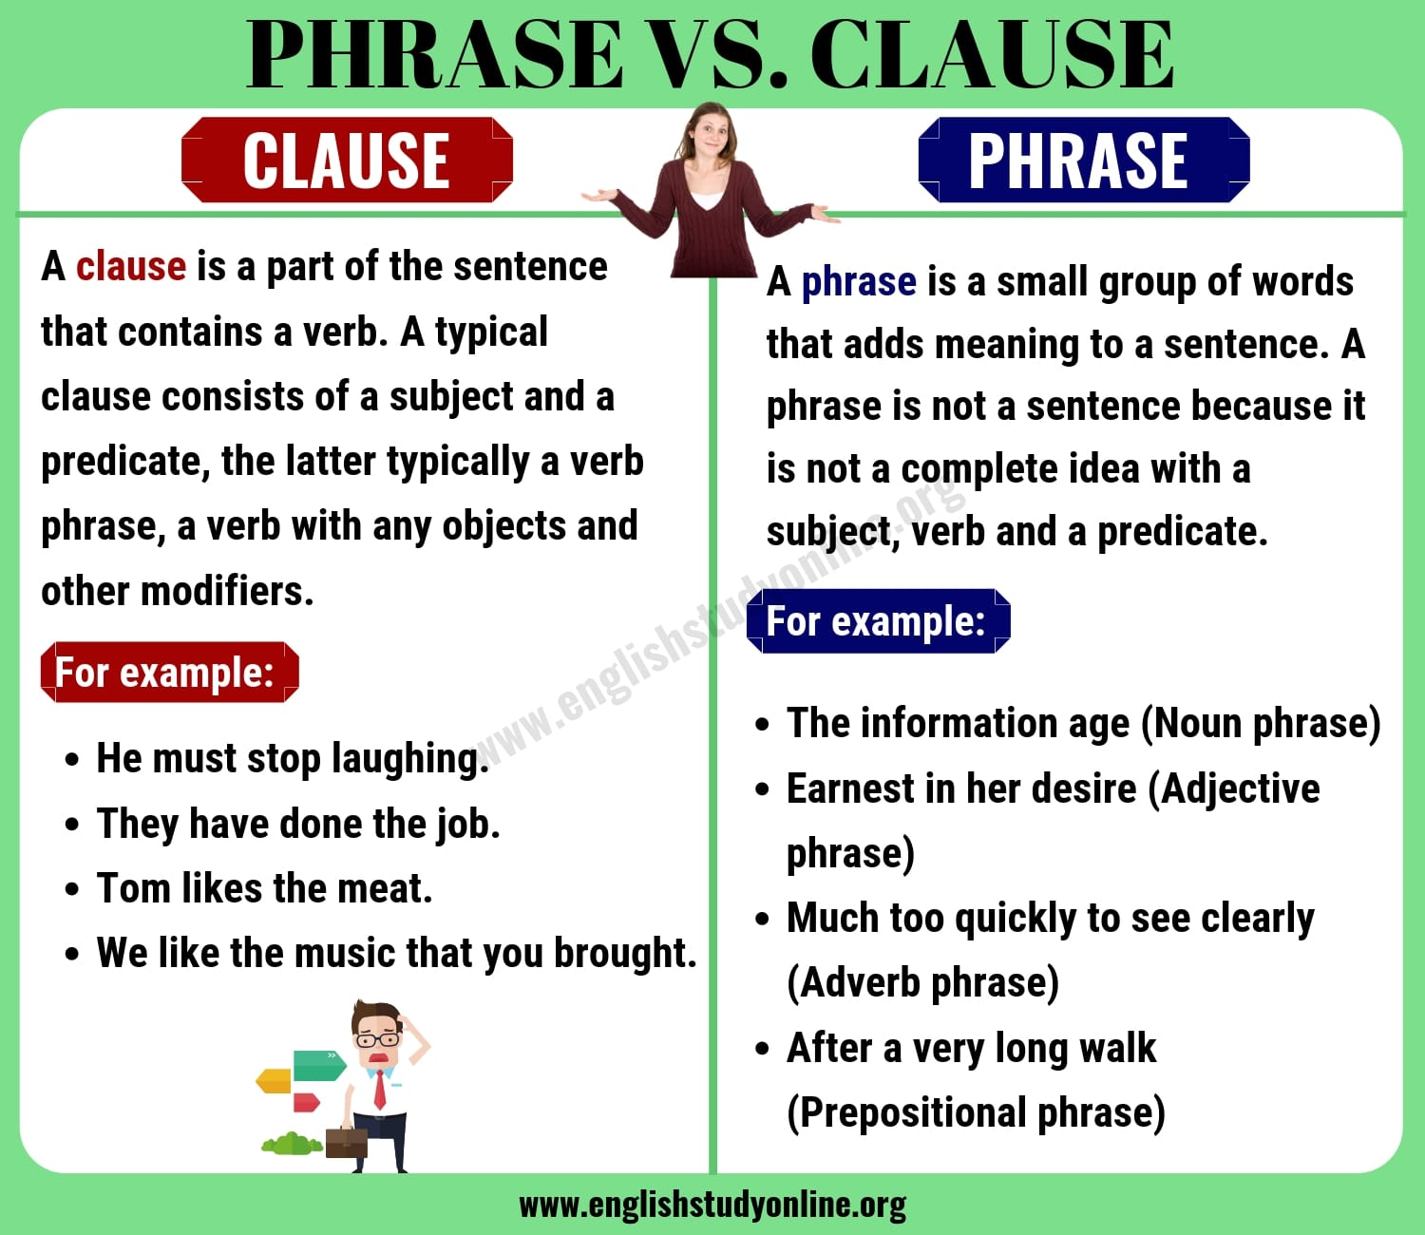
Clause vs. Phrase

Slide 10
Sentence construction
All sentences contain clauses.
Simple One clause.
Compound/Complex Two or more Simple sentences
Most simple [sentence]
Subject Verb
The subject in a sentence is the person or thing carrying out an action (verb).
Example: “The Student Browse”
subject
verb

Slide 11
Sentence construction
All sentences contain clauses.
Simple: One clause.
Compound/Complex:
Two or more Simple sentences
Sentences contain
Subject Verb Object
The subject in a sentence is the person or thing carrying out an action (verb). The object in a sentence is involved in an action (verb) but does not carry it out, the object comes after the verb.
Example: “The Student Browse Information”
subject
verb
object

Slide 12
Clause
Clause is a subject and a verb. Incomplete sentence
Example:
Subject
Verb
My Professor loves
incomplete sentence
My Professor loves pizza
complete sentence
Subject
Verb
Object
The Student Browse
incomplete sentence
The Student Browse Information
complete sentence

Slide 13
Sentence construction
Analysis
Verb
Subject
Object
Determine the Verb
Ask a what, who..? question of the Verb.
This will locate the Subject(s)
Example:
“The student Delete the File”
Who “Delete”?
The student
Student is the subject.
“Networking is my favourite Subject”
What “is”?
Networking
Networking is the subject

Slide 14
Parts of English Grammar & Descriptions

Slide 15
Parts of English Grammar & Descriptions
Parts of a sentence
Nouns
Pronouns
Adjective
Verb
Adverbs
Preposition
Conjunction
Interjection
Punctuations
Article (object)
Proper noun (subject)

Slide 16
Nouns(名詞)
Example :
My professor likes to read books and talk.
The doctor visited the patient at the hospital.
Professor, Books
Doctor, Patient, Hospital
Nouns are divided into Common nouns and Proper nouns.
Common nouns (普通名詞) are words for people, animals, places, or things.
Proper nouns (專有名詞) are names for particular people, places, or things. They always begin with a capital letter.

Slide 17
Pronouns(代名詞)
Is a word that takes the place of a common noun or a proper noun.
There are different kinds of pronouns.
Personal Pronouns
The words I, You, He, She, It, We, They are called personal pronouns.
They take the place of nouns and are used as the Subject of the verb in a sentence.
Example :
I have a dog. It is called Husky.
The words Me, You, Him, Her, It, Us, and Them are also personal pronouns.
They take the place of nouns. These personal pronouns are used as the Object of the verb in a sentence.
Example :
My professor is kind. Everybody likes him.

Slide 18
Pronouns
Pronouns and their antecedent An antecedent (先行詞) is the noun or nouns a pronoun refers to or replaces.
Indefinite pronouns (不定代名詞)
Example:
Everybody should sit in his or her seat until the plane has stopped.
everybody is a pronoun. Because it does not refer to any particular person or thing, it is an called an indefinite pronoun.
The pronoun everybody is singular.
few indefinite pronouns are plural. The pronoun they/their is the proper choice for replacing or referring to such indefinite pronouns.
Example: Several – Few, All – Some, Both – Many

Slide 19
Pronouns
Reflexive pronouns (反身代名詞)
Are used when the “receiver” of the action is the same person as the “doer”.
Example:
The children frightened themselves with ghost stories.
Interrogative pronouns (疑問代名詞)
When you ask a question about someone or something, you often start with an interrogative pronoun.
Interrogative pronouns: who, whom, whose, which, what
Example:
Whom will you ask about the schedule?

Slide 20
Adjective(形容詞)
An adjective:
Tells you more about a noun.
Adjectives are describing words which add details about the nouns in a sentence.
Adjectives are usually placed BEFORE the nouns or pronouns they modify.
Example:
A busy street.
However, adjectives can occasionally be found AFTER nouns and pronouns.
Example:
That problem is too difficult.

Slide 21
Comparisons using Modifiers
Sometimes a sentence compares two or more things.
When comparing two things, add “er” to most modifiers, either adjective or adverb.
If the sentence sounds awkward, you use the word more in front of the adjective or adverb instead of adding “er”.
Example: bright: This light is brighter than that one.
When comparing two things, DO NOT add “er” to adverbs ending in “ly”.
Use the word more in front of the adverb instead of adding “er”.
Example: carefully: Barbara drives more carefully than Pat.
Often, more than two things are compared. Some of the rules change when comparing more than two things. Instead of adding “er”, add “est”. Do not add “est” to adverbs ending in “ly”, and use most with modifiers of more than one syllable.
Example:
nice: Our view is the nicest of all the ones on this street.
peaceful: The time I spend at the lake are the most peaceful hours of my day.

Slide 22
Absolute adjectives
Still other words cannot be used in comparisons, because of their meaning.
These words are called absolute adjectives - words such as, correct and dead.
Example:
An answer on a test is either correct, or not correct. It cannot be more correct, or correcter.
If something is dead, it is dead. It cannot be less dead or more dead.
EXAMPLES OF ABSOLUTE ADJECTIVES
Complete, Conclusive,
Final, Immaculate, Level, Perfect, Eternal,
Perpendicular, Perpetual, Right, Square
Round, Spotless,

Slide 23
Determiners(限定詞)
Determiners:
Are words such as this, those, my, their, which.
They are special adjectives that are used before nouns.

Slide 24
Verb (動詞)
In fact, a sentence is not a sentence without at least one verb.
A verb is a word that expresses action or state of being.
Action verbs
Most verbs are action verbs. They show that something is being done or that something is happening.
State of being verbs
A very small number of verbs express a state of being. These non-action verbs are sometimes called linking verbs(連綴動詞)or copula verbs. They show that something or somebody exists.
A list of non-action or linking verbs includes:
am | was | being
is | were | be
are | has been | had been
have been | will be | will have been

Slide 25
Form of Verbs (助動詞)
Helping verbs (助動詞)
A verb can sometimes be made up of more than one word, called a verb phrase. Within a verb phrase, the word that expresses the action is called the main verb and the other words that tell when the situation took place are called helping verbs.
Example:
I will travel to Halifax on the train.
Toni and Jack were finishing the decorating.
We have thought about a vacation this winter.
Did you write that poem?
In the above sentences, will, were, have, and did are helping or auxiliary verb. Travel, finishing, thought, and write are the main verbs.

Slide 26
Verb Tenses
Verbs express states of being or things happening today, in the present; before today, in the past; as well as what will happen after today, in the future.
Every verb has FOUR main forms, called PRINCIPAL PARTS OF VERB.
Present, Past, past participle(過去分詞), Present participle(現在分詞)
Although English has many verb tenses, this module explains four common tenses.
Simple tenses (現在式)
Perfect tenses (完成式)
Progressive tenses (進行式)
Perfect progressive tenses (完成進行式)
Subject-Verb Agreement:

Slide 27
Summary of Verb Tenses
TENSE | HELPING | EXAMPLE
Simple Past | none | I walked
Simple Present | none | He sings
Simple Future | shall or will | They will sing
Past Perfect | had | We had hit
Present Perfect | has, have | She has carried
Future Perfect | shall/will have | I shall have rung
Past Progressive | was, were | He was hearing
Present Progressive | am, is, are | You are finding
Future Progressive | shall/will be | She will be fitting
Past Perfect Progressive | had been | I had been sitting
Present Perfect Progressive | has/have been | He has been filling
Future Perfect Progressive | will have been | We will have been biting

Slide 28
Irregular Verb
As you may have noticed, some verbs form their principal parts by changing their spelling. These verbs are called irregular verbs.
Example:
PRESENT | PAST | PAST PARTICIPLE
Throw | Threw | Thrown
Feel | Felt | Felt
Spring | Sprang | Sprung
Ring | Rang | Rung
Bring | Brought | Brought
Burst | Burst | Burst
Eat | Ate | Eaten
Rise | Rose | Risen
Raised | Raised | Raised
Swim | Swam | Swum
Cut | Cut | Cut

Slide 29
Adverbs(副詞)
An adverb is a word that describes a verb. It tells about an action, or the way something is done. A lot of adverbs end in –ly.
Some adverbs describe the way something is done. They are called adverbs of manner (情態副詞).
Example: slowly, terribly
Some adverbs describe when something happens. They are called adverbs of time (時間副詞).
Example: yesterday, later, now
Some adverbs describe where something is happened. They are called adverbs of place (位置副詞).
Example: here, there

Slide 30
Preposition(介系詞)
Prepositions are little words that show the relationship between nouns/pronouns or tell when, where, how the action in a verb took place.
Prepositions are always part of a group of words called a prepositional phrase.
Prepositions of Movement: to; towards
To in order to express movement toward a place.
Example: They were driving to work together.
Unnecessary Prepositions
Example:
She wouldn't let the cat inside of the house. [or use "in"]
Where is your college at?
“As a general rule: do not end a sentence with a preposition”.

Slide 31
Conjunction(連結詞)
Conjunctions
Joining two words and are sometimes called connectives.
A conjunction may join words, phrases or clauses.
Types of Conjunctions
Coordinate Conjunctions (對等連接詞)
Join words that are the same part of speech: a noun with a noun; an adjective with an adjective; and so on.
There are only seven coordinate conjunctions:
and, but, or, nor, for, yet, so
Example:
The cat and the dog always eat and sleep together (2 nouns; 2 verbs)
The young and restless children ran quickly and effortlessly.(2 adjectives; 2 adverbs)
He always gets lost, yet he never carries a map. (2 ideas)

Slide 32
Conjunction
Correlative Conjunctions: (相關連接詞)
This small group of joining words are similar to coordinate conjunctions, but they are always used in pairs.
not only/but also
Example: Toni was not only late, but also at the wrong address.
neither/nor
Example: Toni was neither on time, nor at the right address.
either/or
Example: Toni was either late, or lost.
whether/or
Example: I don't care whether Toni gets here or not

Slide 33
Conjunction
Subordinate Conjunctions: (從屬連接詞)
Another group of words are often used as conjunctions. They are used to join two ideas which otherwise would require two separate sentences.
Example:
She was confused. She didn’t ask any questions.
Although she was confused, she didn’t ask any questions.
The road was slippery. The truck drivers stopped carefully.
The truck drivers stopped carefully because the road was slippery.
Some Common Subordinate Conjunctions.
after*, since*, whether, although, while, where, as, than*, why, as if, though, when, because, unless, how, before* until*, even if, if
The words with an asterisk (*) may sometimes be used as prepositions.

Slide 34
Conjunction
Conjunctive Adverbs: (連詞副詞 )
Used to join two complete sentences that are very closely related in meaning.
Example:
Lightning struck the old farmhouse.
The old farmhouse burned to the ground.
A writer might choose to say:
Lightning struck the old farmhouse; therefore, it burned to the ground.
Lightning struck the old farmhouse; consequently, it burned to the ground.
When a conjunctive adverb is used to join two complete sentences, place a semicolon in front of it and a comma after it .
Some Common Conjunctive Adverbs. therefore, moreover, thus, consequently, as a result, however,
nevertheless, hence, otherwise, besides, anyway,
instead, meanwhile, furthermore, still

Slide 35
Interjections(感歎語)
Is word that expresses a sudden, strong feeling such as surprise, pain, or pleasure.
Are exclamations and may be followed by an exclamation point (!) or a comma. They are straightforward and simple to use because they are not related to any other word in the sentence.
Example:
Wow, did you see The Grateful Professor presentation.

Slide 36
Punctuation(標點符號)
Punctuation marks:
Are signs such as periods, commas and question marks. We use them in sentences to make the meaning clear.
Periods(.): at the end of a sentence.
Comma(,): between nouns and noun phrases in a list.
Exclamation point(!): is often used after a commend, an interjection, or a word that shows surprise or anger.
Question mark(?): after a question.
Apostrophe(‘): use an apostrophe with an S(‘S) to show who owns something.

Slide 37
Full forms and short forms
In informal writing, some words have a short form.
For example:
Full form: It is easy to control.
Short form: It's easy to control.
In short forms we use 'm (= am), 're (= are), 's (= is/has), 've (= have), 'd (=had/would) and n't (= not) in combination with other words.
These are the main short forms. Pronoun + auxiliary verb
I'm you're we're they're he's she's it's; I've you've we've they've; I'd you'd he'd she'd we'd they'd; I'll you'll he'll she'll it'll we'll they'll Question word + auxiliary verb who's who'll who'd; what's what'll; where's; when's; how's Auxiliary verb + not aren't isn't wasn't weren't; haven't hasn't hadn't don't doesn't didn't

Slide 38
I’m | I’ve | I’d | I’ll
You’re | You’ve | You’d | You’ll
He’s |  | He’d | He’ll
She’s |  | She’d | She’ll
It’s |  | It’d | It’ll
We’re | We’ve | We’d | We’ll
They’re | They’ve | They’d | They’ll
’m = am, ’s = is or has, ’re = are | ’ve = have | (Had) (Would) | (Will)

Slide 39
Punctuation (標點符號)
A sentence ends with a full stop, a question mark or an exclamation mark.
For example:
STATEMENT Full stop We’ve got the best bargains.
QUESTION Question mark Have you booked a holiday?
EXCLAMATION Exclamation mark What a bargain!
There are a number of ways of punctuating two main clauses.
For example:
Full stop between separate sentences
Shakespeare wrote plays. He also acted on the stage.
Semi-colon between separate clauses
Shakespeare wrote plays; he also acted on the stage.
Comma between clauses linked by and, but or so
Shakespeare wrote plays, and he also acted on the stage.

Slide 40
A /an, the, zero article
A/AN
Uses | Examples
First mention | I saw an old woman and a dog in the park.
Jobs | Paula is a teacher.
Descriptions | Paris is an interesting city.

Slide 41
A /an, the, zero article (冠詞)
the
Uses | Examples
Second mention | I saw a man and a dog. The man was old.
Specific things | The children are in the garden.
Only one thing | The moon looks beautiful today.
Common places | We are going to the park.
Superlatives | He is the best student in the class.

Slide 42
A /an, the, zero article
Zero article
Uses | Examples
General meaning | I don’t like children (Children in general).
Meals | What time do you have breakfast?
Years, months, and dates | 2005 was a great year.
TV | There’s a good film on TV.
Next, last | We went to the theater last week.

Slide 43
Lists
In a list of more than two noun phrases, we use commas.
The last two items are linked by and or or, often without a comma.
For example,
The official languages of the United Nations are Chinese, French, Spanish, Russian (,) and English.

Slide 44
The hyphen (連字符號)
The rules about when to use a hyphen are not very exact.
The hyphen shows that two words belong together. It is usual in compound expressions before a noun.
For example,
Anglo-Irish talks
out-of-date attitudes
a thirty-year-old mother off our
But when these words come after the verb, they are usually separate words.
attitudes that are out of date
We also use a hyphen in compound numbers below 100 and in fractions.
forty-seven five hundred and eighty-nine one and three-quarters

Slide 45
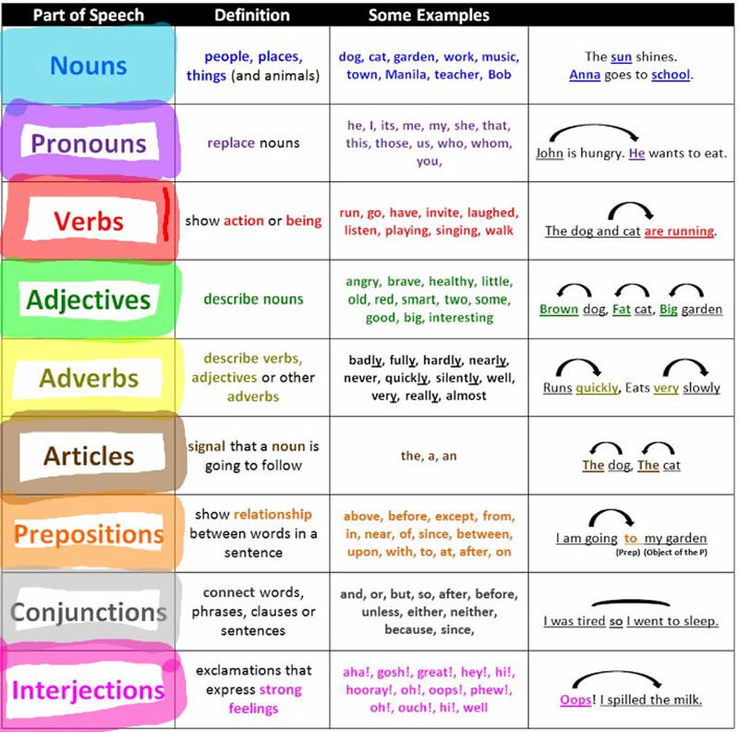
More Examples

Slide 46
Some Notes on Writing

Slide 47
Grammar Writing
A speaker normally uses more words than a writer.
For example,
I had one appointment ...I had another one... had another one... another one...
In writing we might express the meaning like this:
I had appointments at nine o'clock, ten o'clock, half past twelve and quarter past four.
In speech there are often a number of clauses with and one after the other.
So I got... and we... and then we... and we...
“This is less usual in writing”.
.

Slide 48
Necessity
Must and have to
You must… is a way of ordering someone to do something.
You have to… is a way of telling them what is necessary in the situation.
For example:
You must fill in a form.
You have to fill in a form.
No necessity
Needn't and don't have to …
We use needn't and don't have to/haven't got to… to say that something is unnecessary.
For example:
You need not always make an appointment
You do not always have to make an appointment.

Slide 49
Permission
can, could, may, might and be allowed to
We use can or may to give permission. May is formal and used mainly in writing.
For example:
Any person over 18 years may/can apply to join the club.
You can use my phone if you like.
Asking permission
We use can, could or may to ask permission
For example:
Could I borrow this calculator, please?

Slide 50
Probability
We use should and ought to to say that something is probable, either in the present or the future.
For example:
They should have/ought to have our project by now.
We should know/ought to know the result soon.
Possibility
may, might, can and could
We use may and might to say that something is possibly true.
For example:
I may drive up to Taichung on Saturday. There are one or two things I need to do there.
That may not/might not be a bad idea.

Slide 51
Conjunction + participle (分詞)
We can use an active or passive participle after when, whenever, while, once, until, if and although.
For example:
You should wear gloves when using an electric saw.
Reason
A participle clause can express reason.
For example:
Crowds were waiting at the airport, hoping to see professor arrive. (= ... because they were hoping to see her arrive.)
Result
An active participle after the main clause can express result.
For example:
The film star made a dramatic entrance, attracting everyone's attention.

Slide 52
Participle + noun
We can use an active or passive participle before a noun.
Active:
For example:
Boiling water turns to steam. (= water which is boiling)
Passive:
For example:
I had a reserved seat. (= a seat which had been reserved)

Slide 53
Active versus passive voice in scientific writing
The active voice promotes simple, straightforward writing. As such, most scientific journals encourage the use of the active voice over the passive voice.
Active voice – the subject acts.
Passive voice – the subject is acted upon.
The active voice is direct, clear and concise. The passive voice is indirect, but sometimes it is useful to emphasize the research, instead of the researcher.
When to use active or passive voice?
For example:
Present tense – tense often used for Aims.
Active: In this study, we present our design of an electric hot water tank.
Passive: In this study, a design of an electric hot water tank is presented.

Slide 54
Active versus passive voice in scientific writing
Present perfect-tense often used in the Introduction/Discussion/Conclusion
For example:
Active: Previous studies have used comparative analysis of wireless network system to elucidate security issues among different communication device.
Passive: Comparative analysis of wireless network system has been used in previous studies to elucidate security issues among different communication device.
Past tense – tense often used in the Materials and Methods/Results
For example:
Active: We determined the presence of D2D users communication in an area of 5X5km^{2.}
Passive: The presence of D2D users communication was determined in an area of 5X5km^{2.}

Slide 55
Logical Structure of Writing and Presenting Articles

Slide 56
How to scientific writing?
Why is language important scientific writing?
Written communication is key to transmitting knowledge and version an impact on the field.
Without clear and proper language, readers will not grasp the full message or impact of your work. Even though the findings you report might be cutting edge, poor language quality, including errors in grammar, spelling or language usage, could delay publication or lead to outright rejection of the paper.
Use proper English throughout the entire manuscript, and do not forget the captions and headings in figures, charts, graphs, and photos.
Prevent spelling errors by using a spellchecker in English. Additionally, other common language errors involve:
Tenses , Grammar, Sentences, paragraphs
You should always read the journal's Guide for Authors to check for any additional language specifications.

Slide 57
Using Tenses in scientific writing
Tenses:
Take care to use the proper tenses when describing your work and findings.
Being consistent and correct in your use of tenses makes your paper easier to understand.
For example:
Present tense: Use the present tense for known facts and hypotheses,
“The average life of a honey bee IS 6 weeks..."
Past tense: Use the past tense for describing experiments that have been conducted and the results of these experiments.
"The average life span of bees in our contained environment WAS 8 weeks…"
Remember:
Avoid shifting tenses within a unit of text: paragraph, sub-section or section.

Slide 58
Cont…
Grammar:
The passive voice can be used in the Methods section of a paper but otherwise, the active voice will usually shorten sentences and make them more dynamic and interesting for the reader.
Avoid abbreviations and acronyms.
Avoid contractions such as "it's", "isn't", or "weren't" which are not often used in professional writing.
Avoid abbreviations/acronyms except for very well-known ones.
Avoid acronyms as replacement for citations.
Avoid acronyms in the abstract and conclusion.
Eliminate redundant words or phrases.
For example: due to the fact that ➞ because or since
in order to determine ➞ to determine

Slide 59
Cont…
Sentences:
To write a successful manuscript, first be aware of the sentence structure you use.
Write direct and short sentences.
The average length of sentences in scientific writing is only about 20 - 25 words.
Include only one piece of information per sentence.
Sentences should be constructed in short, factual bursts. Long and complicated sentences tend to confuse readers.
Avoid making multiple statements in one sentence.
Convey only a single idea per sentence. Link sentences together within a paragraph to provide a clear story-line.
Keep related words together.
Closely place the subject and verb to allow the reader to understand what the subject is doing

Slide 60
Cont…
Paragraphs:
Have one paragraph for each distinct topic.
Begin a paragraph with a topic sentence, and end in conformity with the beginning.
Avoid a succession of loose sentences.
Provide a logical transition from one paragraph to another to render a clear flow, thus guiding the reader from one topic to another.
Fill logical holes empathizing with a smart reader who genuinely wants to understand the flow of ideas.
Avoid subjective or redundant words or phrases that will date the paper.
For example:
"high resolution" , "new result" , "latest finding"
Avoid subjective or judgmental adjectives.
Avoid expressions of belief. (e.g. "We believe this programming result to be true." )

Slide 61
Always remember your reader
Abstract: the key points
The abstract provides a concise summary of the key aims and results.
The introduction
The introduction should lay the ground-work for why the paper is worth reading, and describe where the work fits within the existing literature.
Introduce the novel elements of the paper in the introduction, thus providing motivation for the reader to penetrate the main text.
Do not over-burden the reader by making the introduction too long.
The discussion and conclusion
Readers need to know what they have read and why it was significant.
Remind the reader why this paper was worth reading and publishing.
Concluding sections also provide a venue to set the stage for future research directions.

Slide 62
Cont…
Figures and captions
Figures can be the most important part of a paper. Produce clear and high quality figures along with thorough captions.
Avoid excessive numbers of figures.
Judiciously select those figures that clearly support the presentation.
Allow the reader to digest a figure's main points without reading the text.
Produce high quality figures, even on the first submission!
Edit ➞ Read ➞ Edit ➞ Read ➞ Edit ➞ etc.
Consider the manuscript from a different perspective between each Edit ➞ Read cycle:

Slide 63
Cont…
Honestly deal with mistakes
Mistakes are embarrassing. But they are far more embarrassing if published! So be thankful the mistake was found during review.
If the basis for the paper is undermined by a mistake, then do not try to justify publishing.
Quality over quantity is the ideal.
Do not give up if you believe in your work
Some influential papers that break new scientific ground may be rejected merely because reviewers do not appreciate the results. Be patient and persistent.
Nonetheless, reviewer comments are almost always useful, even if they are wrong!
Some critical or wrong reviewer comments result from poor writing that leads to reviewer misunderstanding and reviewer frustration. Rethink your writing.
Let comments sit, especially negative or harsh comments.

